Slide 1
Fitness Tracker
Mason Anderson and Kadin McWilliams

Slide 2
Why a fitness tracker?

Slide 3
What we wanted
App that allows user to set goal
Log workouts
Display a summary
Check if goal was met

Slide 4
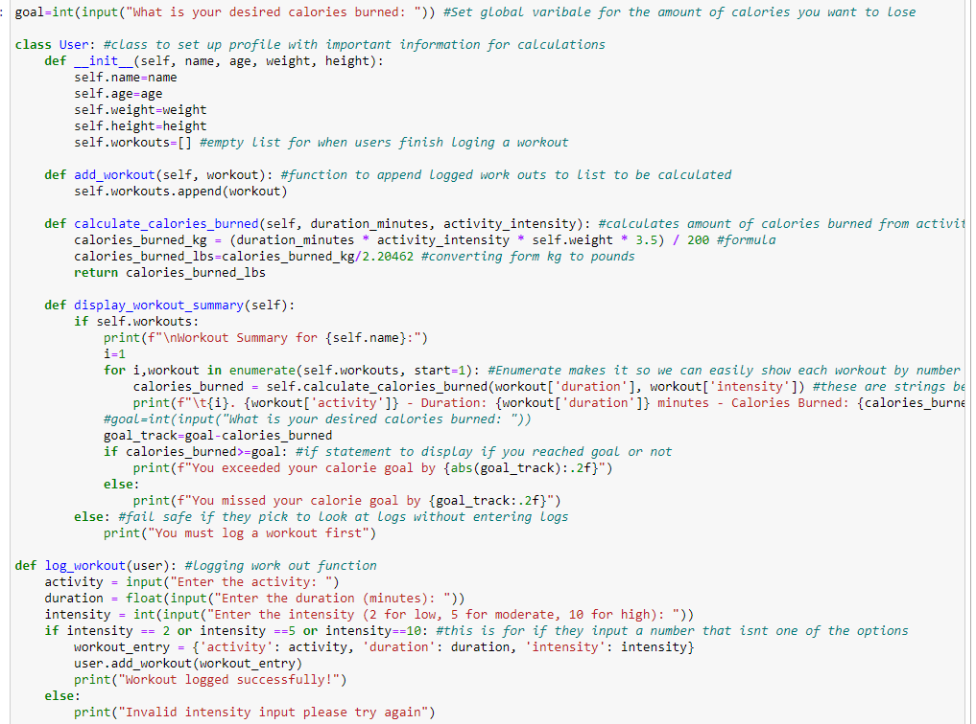
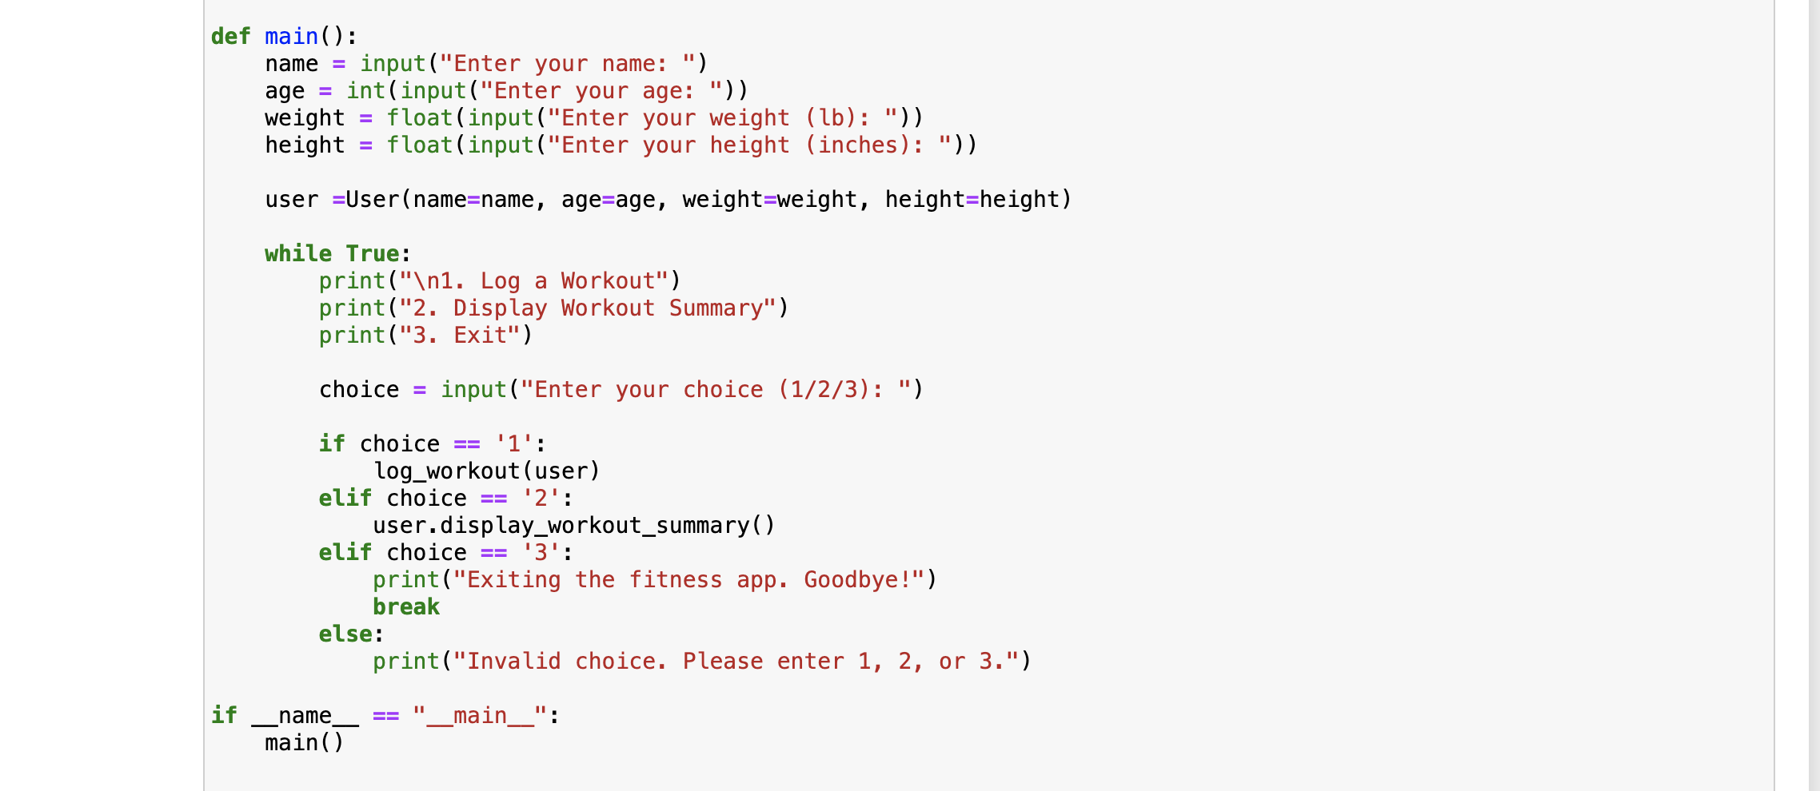
Whole Code Overview

Slide 5
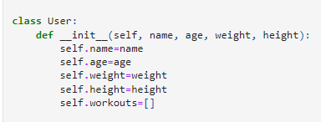
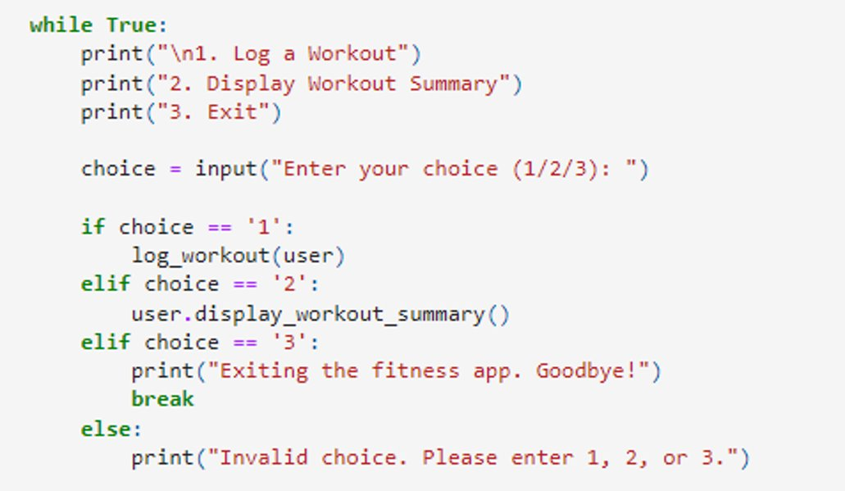
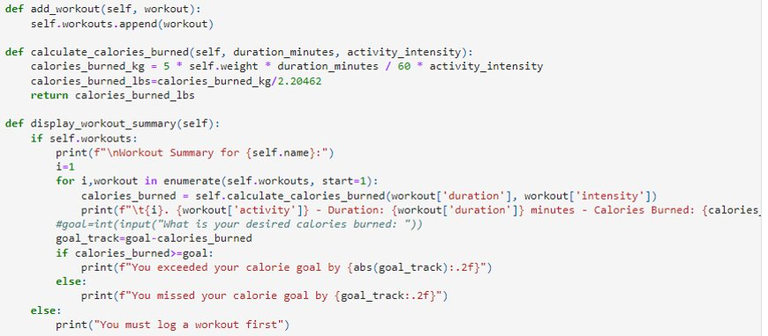
Main Details

Slide 6
Challenges
Originally wanted to use a while loop for our summary, however ran into trouble
Was suggested and taught about the enumerate function

Slide 7
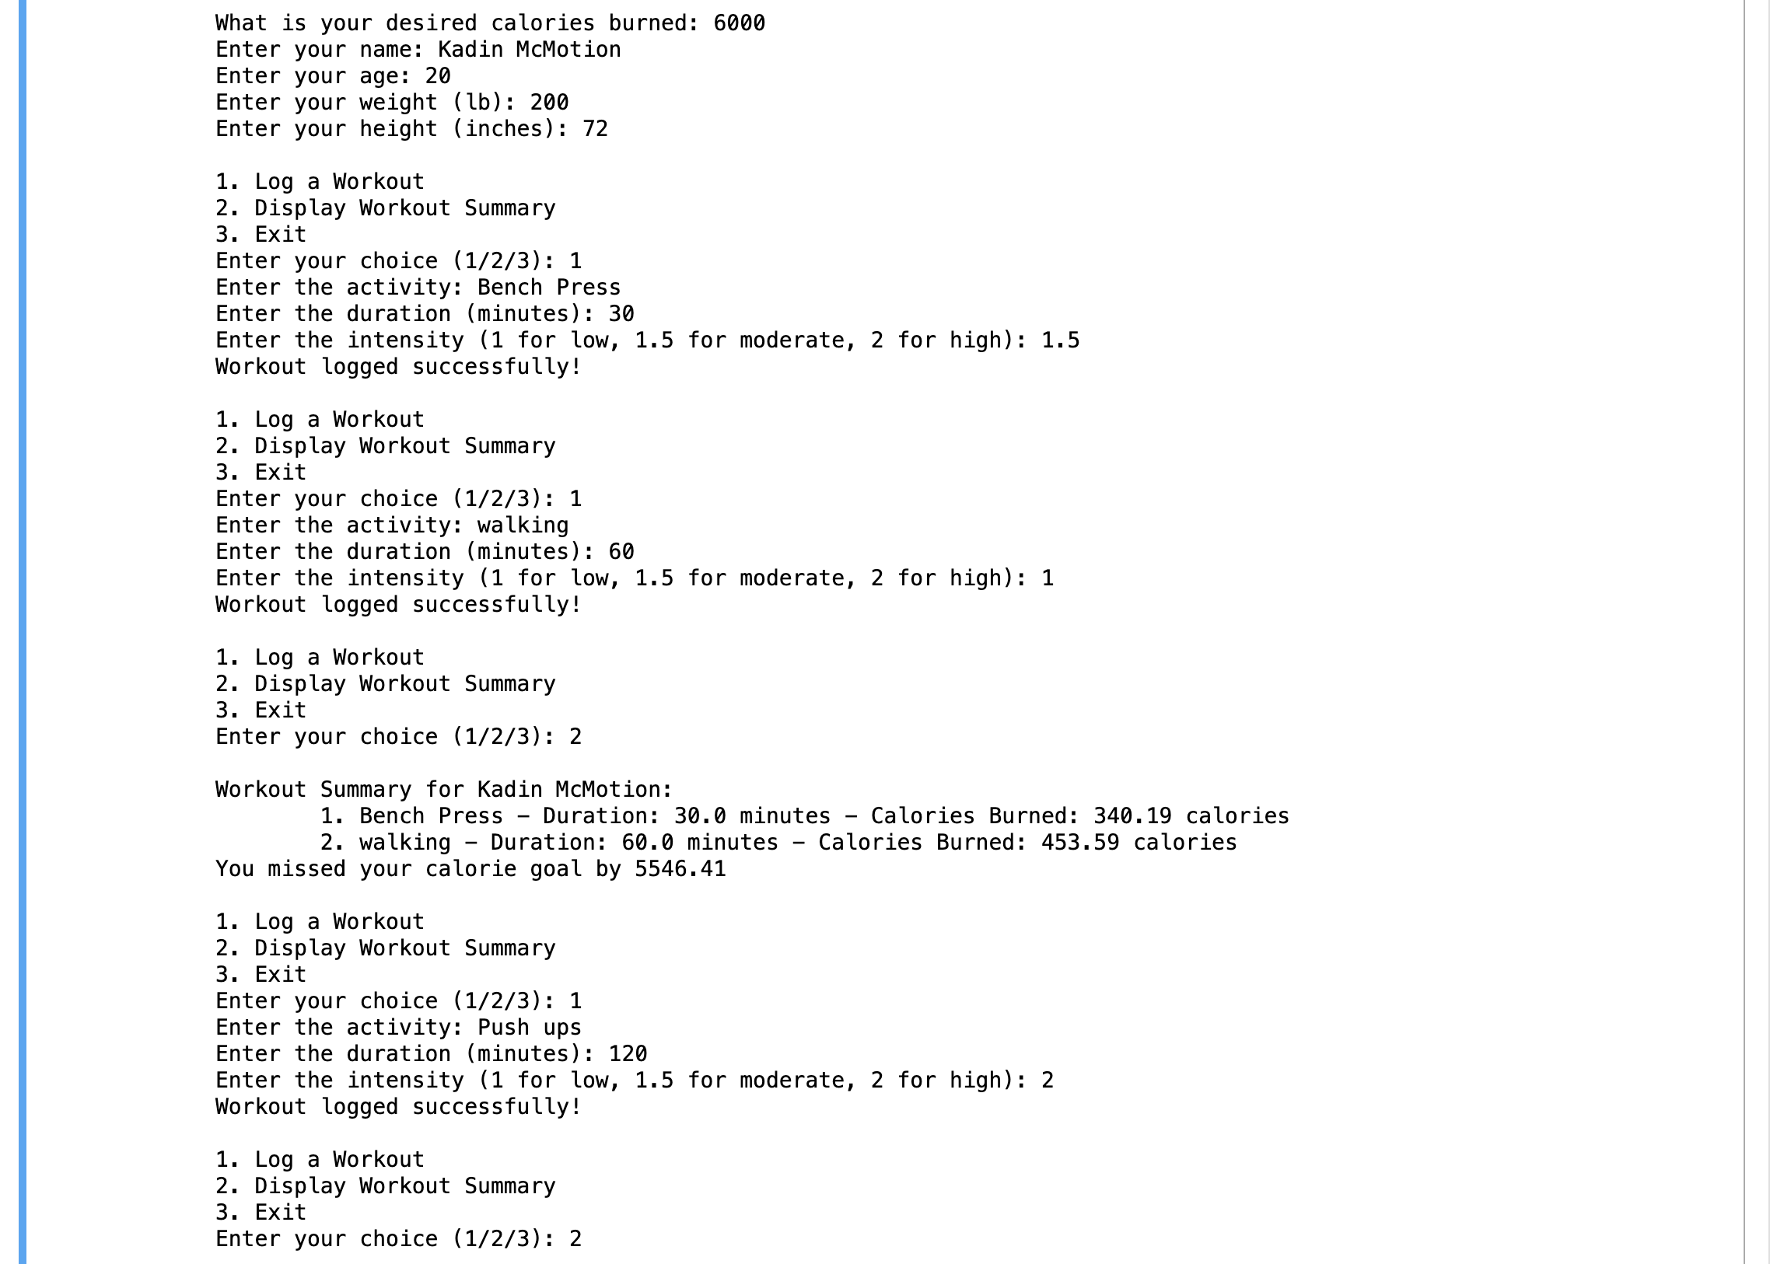
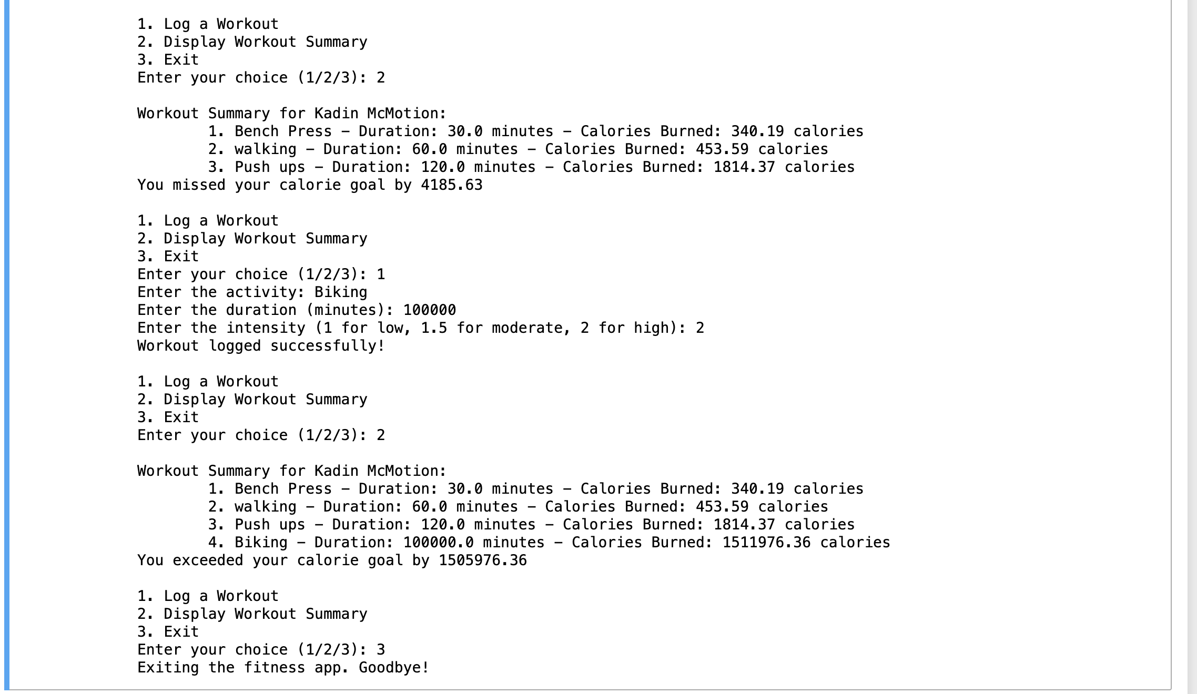
User Experience

Slide 8
What we learned and Improvements
Enumerate
A better way to work on the code together

Slide 9
Code Demonstration

